Slide 1
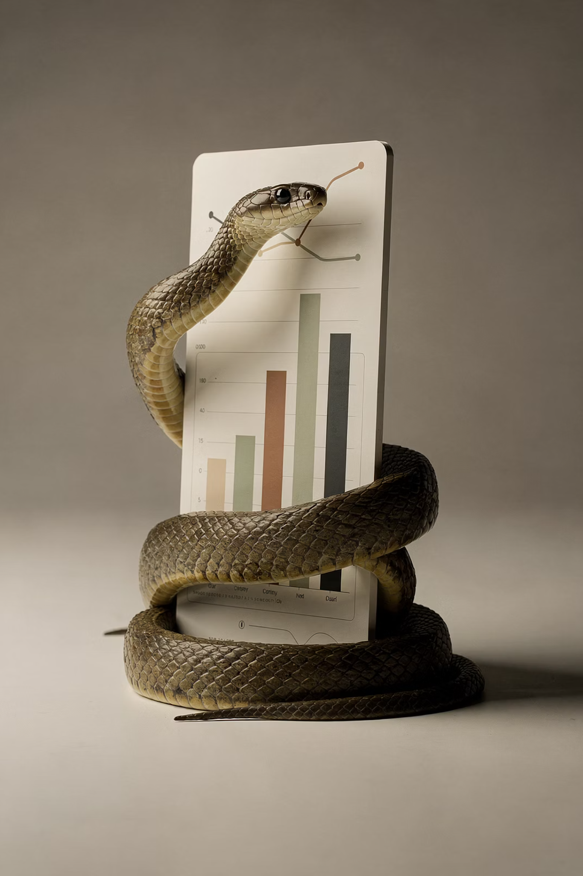

Python for Data Science: A Beginner's Guide
Your first steps into the most powerful language in data science — from zero to writing real programs.

Slide 2

Why Python for Data Science?
Simple Syntax
Massive Ecosystem
Reads like plain English — less time debugging, more time analyzing data.
NumPy, Pandas, Matplotlib, Scikit-learn — all built for data work.
Community & Jobs
#1 language in data science job postings, with millions of tutorials and answers.

Slide 3
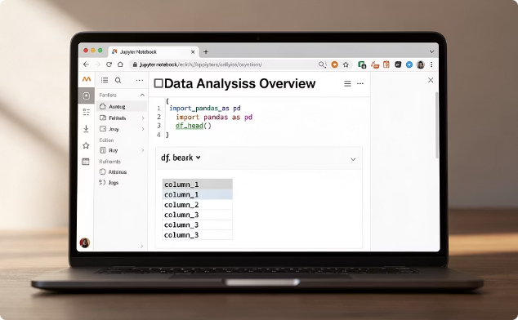
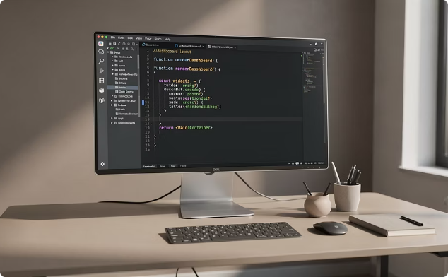

Setting Up Your Environment
Jupyter Notebook
VS Code
Google Colab
Interactive, cell-by-cell execution — ideal for exploration and learning.
Full-featured editor with Python extension; great for larger projects.
Zero installation, runs in the browser, free GPU access included.

Slide 4

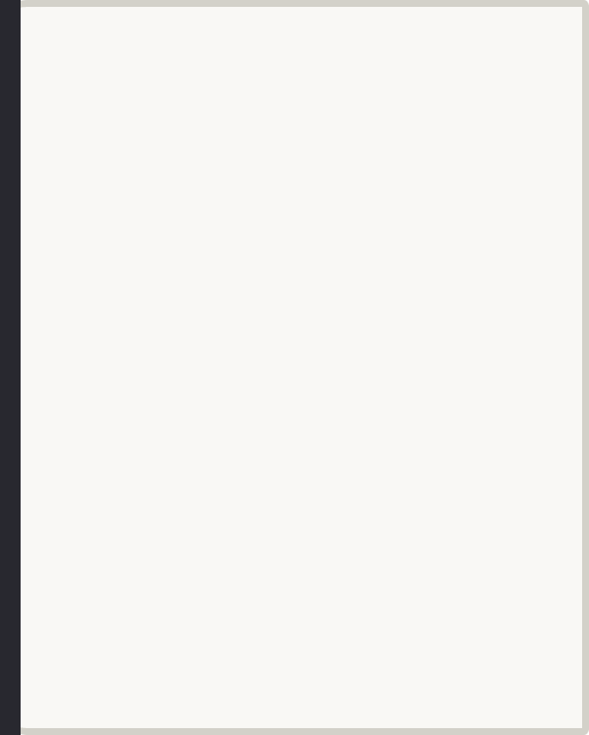
Which Tool Should You Use?
Just Starting Out?
Learning Locally?
Building Real Projects?
→ Google Colab — no setup needed, open a browser and go.
→ Jupyter Notebook via Anaconda — great for interactive exploration.
→ VS Code — professional-grade tools for serious development.

Slide 5

Your First Python Program
The Classic First Step
print("Hello, World!")
Every programmer starts here — printing a message to the screen. In Python, there are no semicolons and no curly braces. Just clean, readable code.
Run this one line and you're officially a Python programmer. The print() function displays any value you pass to it.
No semicolons. No curly braces. Just clean, readable code.

Slide 6
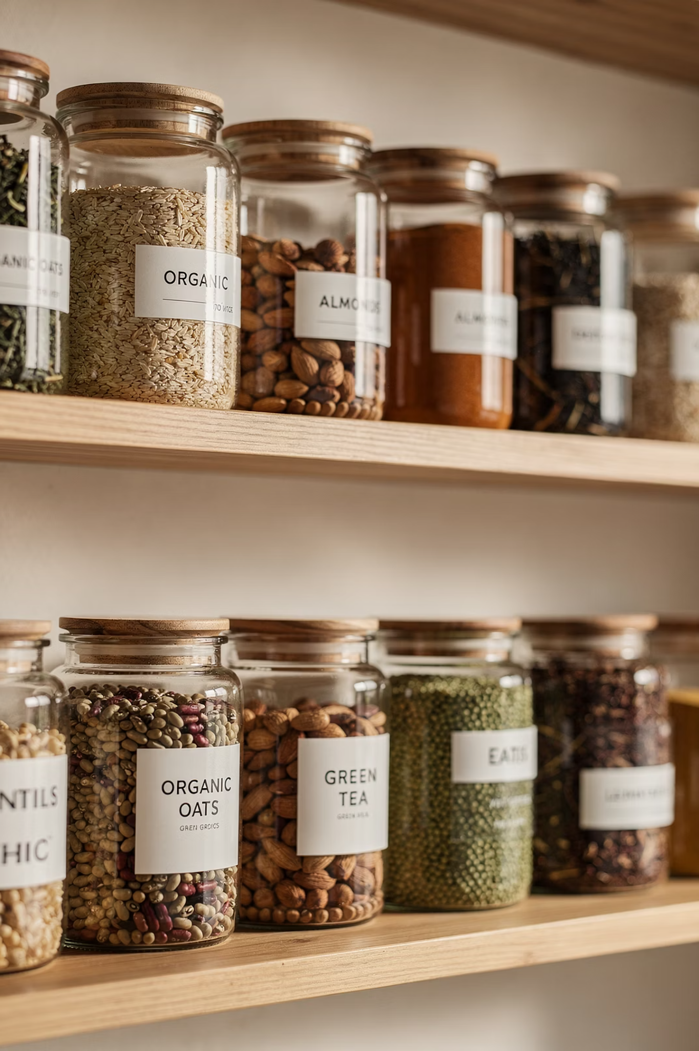

Variables: Storing Information
A variable is a named container that holds a value. Python is dynamically typed — no need to declare the type upfront.
name = "Alice"
age = 25
score = 98.5
Python figures out the type automatically based on the value you assign.

Slide 7




Naming Conventions
Use snake_case
Be Descriptive
student_name, total_score — not camelCase. This is the Python standard.
user_age beats x or a1. Your future self will thank you.
Avoid Reserved Words
Case-Sensitive
print, type, list are already taken by Python — don't use them as variable names.
Score and score are two completely different variables in Python.

Slide 8
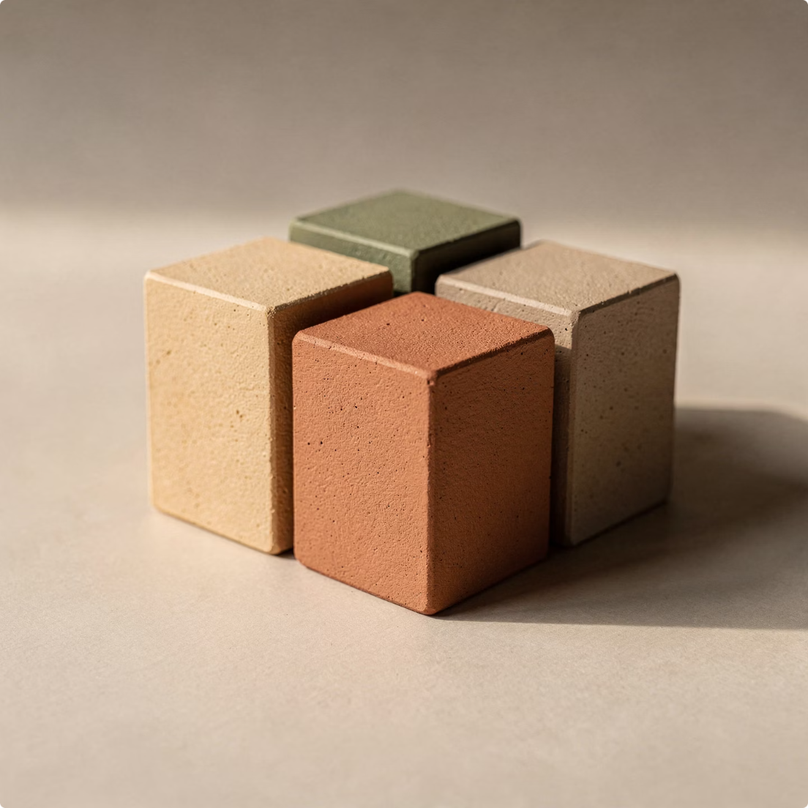
Core Data Types
Type
Description
Examples
int
Whole numbers
42, -7, 1000
float
Decimal numbers
3.14, -0.5, 2.0
str
Text in quotes
"hello", 'Python'
bool
True or False
True, False
These four types are the foundation of almost every Python program you'll write.

Slide 9

Checking a Variable's Type
Use the built-in type() function to inspect any variable — essential when debugging or exploring unfamiliar data.
type(42)
type(3.14)
<class 'int'>
<class 'float'>
type("hi")
type(True)
<class 'str'>
<class 'bool'>
When in doubt about what type a variable is, just call type() on it.

Slide 10


Type Conversion
Converting Between Types
Use Python's built-in functions to convert values from one type to another.
float()
int()
int("5") # → 5
float(3) # → 3.0
str(100) # → "100"
Watch out: int("hello") raises a ValueError — only convert compatible types!
str()

Slide 11

Common Type Conversion Use Cases
1
User input is always a string
Convert to int or float before doing any math.
age = int(input("Enter age: "))
2
Concatenating numbers with strings
You can't add a number to a string directly — convert first.
"Score: " + str(95)

Slide 12
Input & Output Operations
print() — Output
input() — Input
Displays values to the screen. Supports multiple arguments and f-strings for clean formatting.
Pauses the program and waits for the user to type something. Always returns a string.
name = "Alice"
age = 25
print(f"Hello, {name}! You are {age} years old.")
name = input("What is your name? ")
print("Nice to meet you, " + name)
Remember: wrap input() with int() or float() when you need a number.

Slide 13

Putting It All Together
A mini program that combines variables, input, type conversion, and output — everything you've learned so far in one place.
name = input("Your name: ")
age = int(input("Your age: "))
print(f"Hi {name}, in 10 years you'll be {age + 10}!")
input()
int()
print() + f-string
Captures the user's name and age as strings.
Converts the age string to an integer so we can do math.
Formats and displays the result cleanly.

Slide 14

Key Takeaways & Next Steps
✅ What You Learned
🏋️ Practice Now
Python's simplicity makes it the perfect first language for data science
Variables, data types, and I/O are the building blocks of every program
Type conversion lets you work with data in any form you need
Write 3 small programs today using input(), type conversion, and print(). Repetition is how it sticks.
🚀 Up Next
Operators (arithmetic, comparison, logical)
Conditionals (if / elif / else)
Loops (for and while)

